Slide 1
Equality and Inclusion Unit
Supporting Disabled Colleagues
Getting the most from our Business Disability Forum membership
Laura York, Equality and Inclusion Manager, Equality and Inclusion Unit, equality@leeds.ac.uk
Keith Harris, Disability Business Partner, BDF, keithh@businessdisabilityforum.org.uk

Slide 2
Welcome and Introduction
Teams Webinar – captions, recording, transcript, Q&A
Session overview
Webinar outcomes
Why the University is a BDF member

Slide 3
Session overview
About the BDF
Knowledge Hub
Advice Service
Events and webinars
Networks and Taskforces
How to sign up
Questions

Slide 4
Webinar outcomes
Raise awareness and help colleagues get the most from the membership.
Staff using the BDF Advice service and accessing the Knowledge Hub.
Sign up with your work email on the BDF membership signup webpage.
Sign up to the BDF newsletter.

Slide 5
Why the University is a BDF member
Provides specialist advice and expert guidance.
Help us progress disability equity and inclusion.
Lots of practical and specialist resources, developed by experts.
Increase confidence and knowledge when supporting disabled staff.

Slide 6
Keith Harris Disability Business Partner BDF keithh@businessdisabilityforum.org.uk

Slide 7
About the BDF
About us “Business Disability Forum is the leading business membership organisation in disability inclusion. We are trusted partners, working with business, Government and disabled people to improve the life experiences of disabled employees and consumers, by removing barriers to inclusion”
Maximise your membership

Slide 8
BDF Membership Benefits
Advice Service - Support for HR and line managers
Knowledge Hub - Resources and toolkits for HR and line managers.
Events and webinars
Networks and Taskforces
Newsletter sign up - A&Z on Disability

Slide 9
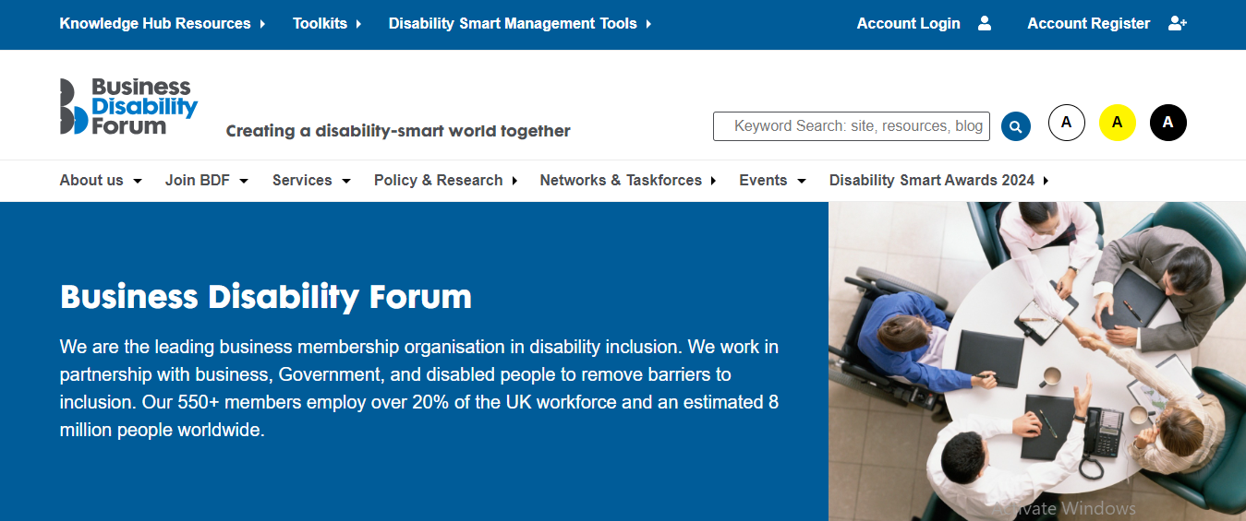
BDF website

Slide 10
Questions

Slide 11
Thank you

Slide 12
University of Leeds Resources
Disability Support and Resources
AccessAble – access guides for University buildings and services
Access to Work - government scheme funding access to equipment, software and support workers for disabled people in the workplace
Adjustments and Support for Disabled Employees – current process
Assistive Technology – dictation, readers, mind mapping notetaking, productivity
Resources for Supporting Disabled Employees – training, diagnosis, specific disabilities
Leeds Accessibility Staff Network
University EDI implementation plan

